Slide 1
From the EU Green Deal to the LightingEurope Strategy 2030
Policy debate
Light & Building – Messe Frankfurt- 05 Feb 2024
Commission’s activities on enforcement of ecodesign and energy labelling rules
Ronald Piers de Raveschoot
Policy Officer
Energy Efficiency - Buildings and products
European Commission, Directorate General for Energy
©istock_romaset

Slide 2
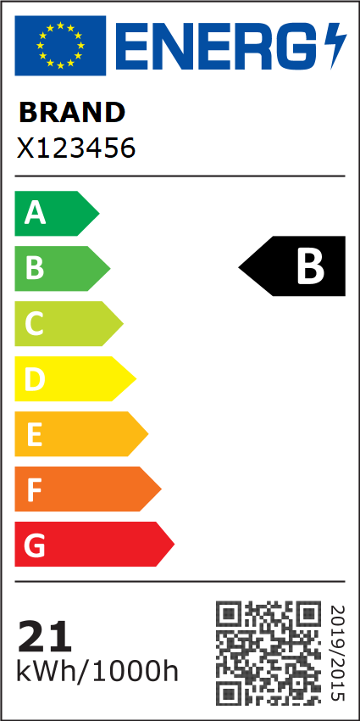
Ecodesign & energy labelling
  Ecodesign (ED): sets minimum efficiency requirements for energy-related products
  First rules date from 1992
    Current Legal basis: Directive 2009/125/EC, based on article 114 TFEU (internal market harmonisation)
  Energy labelling (EL): provides information on energy efficiency and other key performance criteria to consumers, enabling them to make informed choices.
  First labels date from 1979
    Current Legal basis: Regulation (EU) 2017/1369, based on article 194 (energy)
    (Tyres labelling: Regulation (EU) 2020/740)
  Both frameworks are based on the concept of:
  « placing on the market » of products, or
  « putting into service » (mainy for own use),
  relying on what can be verified at that moment, either through testing
  on products or by checking technical documentation

Slide 3
Policy context:
Need for action greater than ever !
Climate change & Green deal (Dec 2019): EU carbon neutral by 2050
Circular economy & CEAP (Mar 2020)
Fit for 55 package (Jul 2021): 55% reduction CO₂ emissions by 2030 + 9% additional energy savings in the recast of the EED
Current crisis: EU Energy security and energy prices
Ecodesign and energy labelling remain key instruments.
30 Mar 2022 Commission adopted:
  Proposal for a new ‘Ecodesign for Sustainable Products’ Regulation
  - provisional agreement reached 05/12/2023 between the EU Parliament and the Council
  Ecodesign and energy labelling Working Plan 2022-24

Slide 4
About 50 Measures in place
31 Ecodesign regulations
1275/2008 Electric power consumption standby and off mode
107/2009 Simple set-top boxes
641/2009 Circulators
327/2011 “Industrial” fans
206/2012 Air-conditioning products and comfort fans
547/2012 Water pumps
932/2012 Household tumble driers
666/2013 Vacuum cleaners
801/2013 Networked standby
813/2013 Space heaters
814/2013 Water heaters & storage tanks
66/2014 Domestic ovens, hobs and range hoods
548/2014 Power transformers
1253/2014 Ventilation units
2015/1095 Professional refrigeration
2015/1185 Solid fuel local space heaters
2015/1188 Local space heaters
2015/1189 Solid fuel boilers
2016/2281 Air heating and cooling products, process chillers
2019/424 Servers and data storage products
2019/1781 Electric motors
2019/1782 External power supplies
2019/1784 Welding equipment
2019/2019 Household refrigerating appliances
2019/2020 Light sources
2019/2021 Electronic displays (televisions)
2019/2022 Household dishwashers
2019/2023 Household washing machines
2019/2024 Commercial fridges
2023/1670 Smartphones, mobile phones, cordless phones & slate tablets
17 Energy labelling Regulations
626/2011 Air conditioners
392/2012 Household tumble driers
811/2013 Space heaters
812/2013 Water heaters & storage tanks
65/2014 Domestic ovens, hobs and range hoods
1254/2014 Residential ventilation units
2015/1094 Professional refrigeration
2015/1186 Local space heaters
2015/1187 Solid fuel boilers
2019/2013 Electronic displays (televisions)
2019/2014 Household washing machines
2019/2015 Light sources
2019/2016 Household refrigerating appliances
2019/2017 Household dishwashers
2019/2018 Commercial fridges
2020/740 Tyres labelling
2023/1669 smartphones and slate tablets
2 Voluntary agreements
COM (2012) 684 Complex set top boxes (discontinued 2020)
COM (2013) 23 Imaging equipment
COM (2015) 178 Game consoles
Note: Check our web page for more up-to-date info:
https://commission.europa.eu/energy-climate-change-environment/standards-tools-and-labels/products-labelling-rules-and-requirements/energy-label-and-ecodesign/energy-efficient-products_en

Slide 5
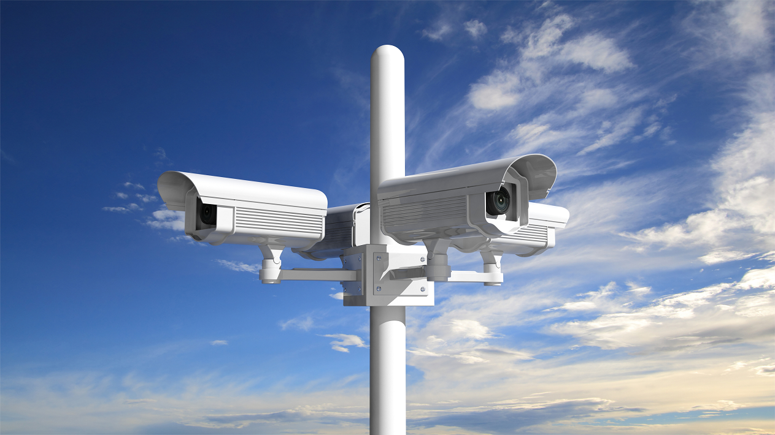
Market surveillance
(Checking that products comply with applicable requirements
and take remedial action if required)
=
Cornerstone of the ED and EL framework
©istock 2022
Incentive for manufacturers to comply
Gives confidence to customers
Level playing field for industry (single EU market)
Allows the energy savings and other policy objectives to materialise

Slide 6

Organisation of Market surveillance in the EU
Product legislation is set at EU level
Member States are responsible for the enforcement
Common market surveillance framework :
Regulation (EU) 2019/1020
    How to organise
    What to investigate
    What procedures to follow when problems found
    How to cooperate

Slide 7

Organisation of market surveillance
©istock 2022
Member States have to:
  designate one or more market surveillance authorities in its territory
  ensure that their respective duties are clearly defined and that they can collaborate closely
  provide them with the necessary resources and powers (including those specified in the Regulation)
  appoint a single liaison office

Slide 8

Activities of market surveillance authorities
Market surveillance authorities shall conduct their activities in order to:
  Ensure effective market surveillance within their territory, of products made available online and offline;
    (e,g. “perform appropriate checks on the characteristics of products on an adequate scale”)
  Ensure that economic operators take appropriate and proportionate corrective action in case of compliance issues;
  Take appropriate and proportionate measures where the economic operator fails to take corrective action.

Slide 9

Manufacturer’s role
©istock 2022
Design, manufacture and test the product with the requirements in mind
Assess the conformity of the product
Upon positive assessment, draw up the Declaration of Conformity and affix the CE marking. By doing so, the manufacturer ensures and declares under his sole responsibility that the product satisfies the requirements.
Draft the technical documentation, making possible an assessment of the conformity of the product with the requirements (test reports),
takes all measures necessary so that the manufacturing process ensures compliance of all units produced

Slide 10
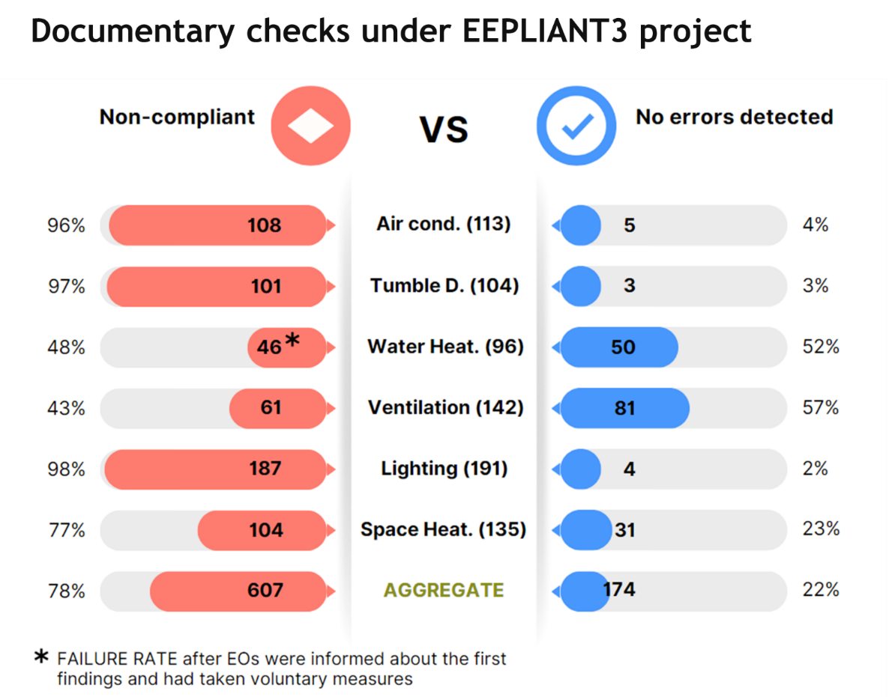
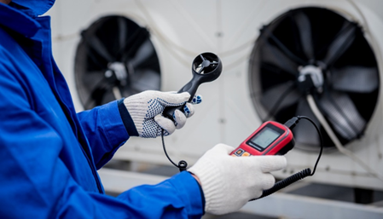
Compliance issues !
NB: these products are sampled on a risk-based approach, and therefore the results cannot be considered as representative of the market situation.
©istock_romaset

Slide 11
The EU Product Compliance Network
4. Support by the Commission : different levels
Permanent structure for coordination & cooperation between MS authorities and the Commission
- Collaboration with customs
- Development of indicators
- EU testing facilities
- Funding, training,
- ICSMS tool and other IT tools…
- Ect.
(see articles 29-33 of Regulation (EU) 2019/1020)

Slide 12

The ED and EL Administrative Cooperation Groups (AdCos)
Nick Youngson CC BY-SA 3.0 Pix4free
At the operational level, EU cooperation on market surveillance takes place through ADCOs - informal groups of market surveillance authorities:
Supported and financed by the Commission
Meet twice a year for 2 days
Aims at harmonising approaches, learning from each other, coordinating actions, developing common tools etc.
Subgroups work on specific topics

Slide 13
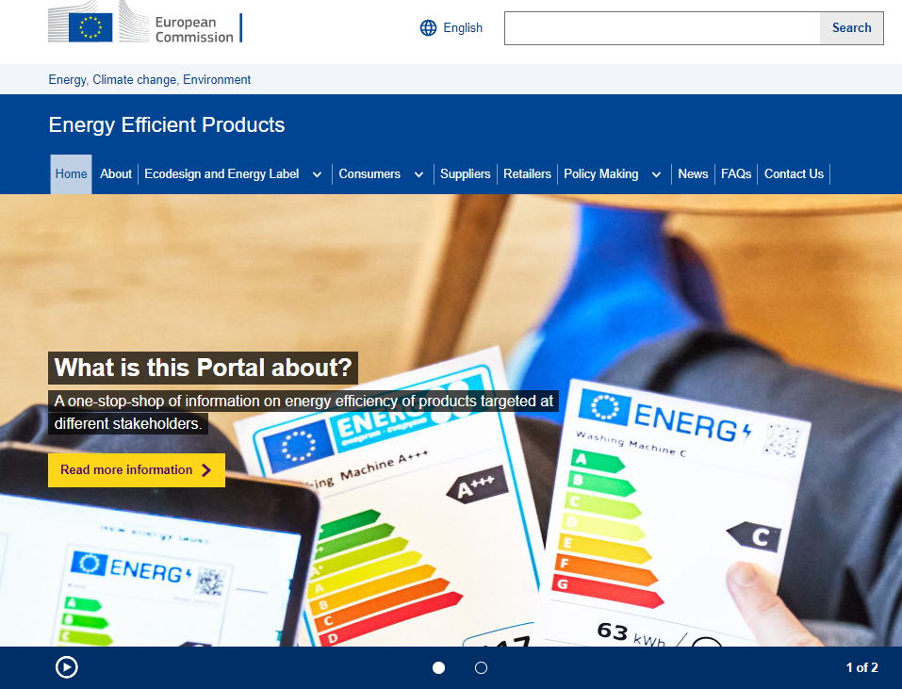
The ED and EL Consultation Forum
One of its role is to "examining the effectiveness of the established market surveillance mechanisms” (Art 18 of the ED Directive)
Made of all interested parties (COM, MSs, Industry, NGOs …)
Constructive discussion on how to improve compliance
The ERPREL database:
Advances search facilities for users
Supplier verification mechanism
Buttons “report a product” or “product missing” (under development)
The ‘ComplianceServices’ project
Improve economic operator awareness and knowledge
The Energy Efficient Products Portal
User-friendly Repository of information for all interested publics
https://energy-efficient-products.ec.europa.eu/index_en
Live in about 1 month !

Slide 14

















Joint Actions (EU funded projects)
Notes:
That is why the Commission supported a number of projects to assist the development of market surveillance (not all depicted are about market surveillance, but at least half of them are)

Slide 15

Thank you
© European Union 2020
Unless otherwise noted the reuse of this presentation is authorised under the CC BY 4.0 license. For any use or reproduction of elements that are not owned by the EU, permission may need to be sought directly from the respective right holders.
Notes:
Update/add/delete parts of the copy right notice where appropriate.
More information: https://myintracomm.ec.europa.eu/corp/intellectual-property/Documents/2019_Reuse-guidelines%28CC-BY%29.pdf

Slide 16
Union testing facilities
Enhance laboratory capacity and ensure reliability and consistency of testing
accredited and provide services solely to public authorities,
Activities:
  (a) carry out testing of products at the request of market surveillance authorities, the Network or the Commission;
  (b) provide independent technical or scientific advice at the request of the Network;
  (c) develop new techniques and methods of analysis.

Slide 17
ESPR – update and likely impacts
Main changes
Wider product scope
More complex consultation forum
Additional obligations to consider for product regulations
Additional actions e.g. unsold goods, DPP, GPP
Possible horizontal regulations
Transitional regime for 14 ENER ecodesign Directive products
Likely main impacts
Competition between types of products for inclusion in the Working Plan
More resources needed for each product regulation under ESPR
Potential for simplifying [or complicating?] work through horizontal measures
Cross-DG discussions on methodology

Slide 18

IT Tools: ICSMS
Information and Communication System for Market Surveillance
IT platform to facilitate communication between MSAs
allows information on non-compliant products to be quickly and efficiently shared between authorities
Internal/public area
Increased use
New functionalities being implemented

