Slide 1
Smart Lighting systems: Dream or reality
Paolo Bertoldi – European Commission, Joint Research Centre
Georges Zissis, Université de Toulouse, France

Slide 2
Overview and problem setting - 1
In 2040, humanity’s artificial light needs are foreseen to be 285 Plmh.
This corresponds to a light demand increase of 25% compared to 2020.
In 2009 electrical lighting consumed 2650 TWh or 19% of world electricity production
in 2019, we estimated the electricity used for lighting was around 2900 TWh and stable (less than 1% annual growth rate), or 13,5% of the world's annual usable electricity.
Even if the absolute value slightly increased in the last years, the relative part of lighting reduced drastically (~4% annual decrease rate).

Slide 3
Overview and problem setting - 2
The observed decrease is the effect of combined effort of technological developments and worldwide energy policies.
LED technology has evolved so quickly that in 2022 best LEDs lumens per watt (lm/W) offer efficacies over 200 lm/W – double the efficacy of the fluorescent technology – with high color rendering and stability. Today, the best commercialized non-directional LED lamps are 210 lm/W over 15 times more efficient than incandescent and four times more efficient than compact fluorescent lamps (CFLs).
Minimum energy performance standards are widely employed as the key driver for efficiency improvements, incandescent lamps are almost banned worldwide, and many countries are now beginning to eliminate fluorescent lighting.

Slide 4
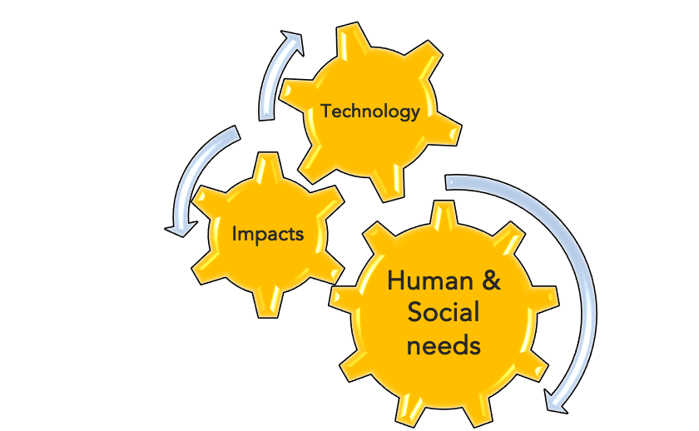
Smart Lighting
Today, lighting is witnessing the its 4th revolution: the transition to Smart Lighting systems. Smart Lighting can achieve more than 40% additional energy savings and its market size can exceed €90 billion by 2030.
A smart lighting is characterized by an intelligent sensing technology that is increasingly being integrated with internet technologies, thereby allowing the reacting to and communicate with the changing environment around it.
This is leading to optimal operation and global improvement in efficiency.

Slide 5
Smart Lighting
“A smart lighting system has a principal function which is to produce, at any moment, the right light: where it is needed and when it is necessary. It should adapt the quantity and quality of light to enhance visual performance in agreement with the type of executed tasks. It must guarantee well-being, health and safety of the end-users. It should not squander passively the resources of our planet and limit actively the effects of light pollution on the biotope, or, any other impacts on the environment. Further, the system could offer additional optional services (geo-localization, data connectivity…) to the end-users preferably through Visible Light Communication protocols, but not only”.

Slide 6
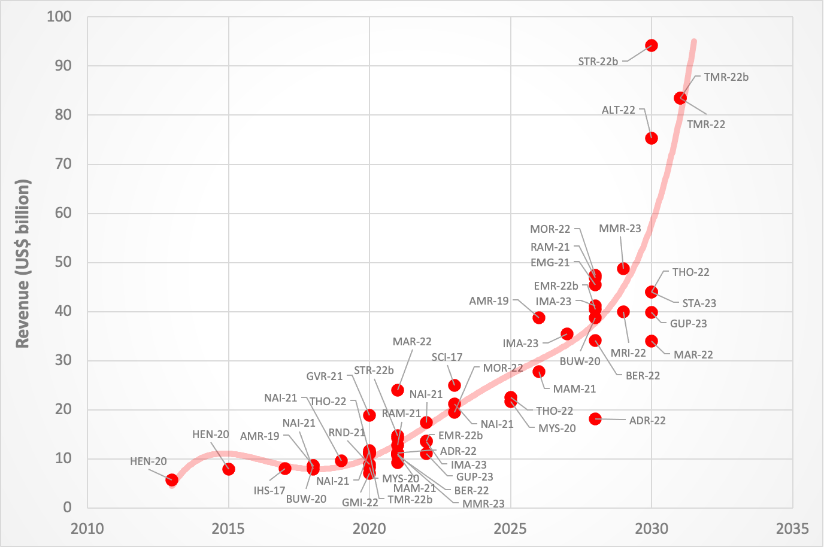
Smart Lighting market size
Notes:
Historically, in 2013, the global smart lighting market industry size exceeded USD 5,7 billion. Among them, the market size of smart lamps and related accessories exceeded USD 1,2 billion. In 2015, the global smart lighting market size reached USD 7,83 billion. [9] An HIS Markit report indicates that in 2017 the smart lighting and connected lighting controls market was estimated to have been worth USD 8 billion; That year, 1,8% of luminaires shipped included connected ballasts and wireless adapters. [10]
Following a mysupplier online publication, the Smart Lighting market is forecasted to grow from USD 8,2 billion in 2020 to USD 21,7 billion by 2025 at a CAGR of 22,3% in the forecast period. [11] According to Business Wire news, the global smart lighting market is expected to generate revenue worth USD 8,68 billion in 2018, and is projected to reach USD 38,68 billion by 2028, to register a CAGR of 20,5% during the 2018-28 period. [12] Research and Markets reports that the global smart lighting market size is expected to reach USD 46,9 billion by 2028, registering a CAGR of 20,4%, from USD 12,75 billion 2021 to 2028. [13] Nair reports that the global smart lighting market will reach USD 21 billion in 2023, and is expected to grow at a CAGR of 22% from 2018 until 2023. [14] Maximize Market Research reports that smart Lighting Market was valued at USD 10,9 billion in 2021 and is expected to reach USD 48,78 billion. by 2029, at a CAGR of 20,6 % during a forecast period. [23] Following Data Bridge report, the market is expected to witness market growth at a rate of 20.45% in the forecast period of 2021 to 2028. [15] Mordor Intelligence expects the Smart Lighting Market size to be at USD 19,42 billion in 2023, and to reach USD 49,37 billion by 2028, growing at a CAGR of 20,52% during the forecast period (2023-2028). [16] Meticulous Research says that the Smart Lighting Market is expected to reach USD 39,91 billion by 2029, at a CAGR of 12,2% during the period of 2022–29. [17] Transparency Market Research forecasts that the global smart lighting market who was valued over USD 11,29 billion in 2020 will estimated to expand at a CAGR of 20,3% from 2021 to 2031 to cross the value of USD 83,52 billion by the end of 2031. Emergen Research believes that the global market size will reach USD 45,47 billion in 2028 and register a revenue CAGR of 19,7% during the forecast period. [18] Market and Markets analysts said that the global smart lighting market size is estimated to be USD 10,9 billion in 2021 and projected to reach USD 27,7 billion by 2026, at a CAGR of 20,5% during the forecast period. [19] B. Thormundsson, published in Statista that the world smart lighting market will reach USD 43,97 billion by 2030. [20]

Slide 7
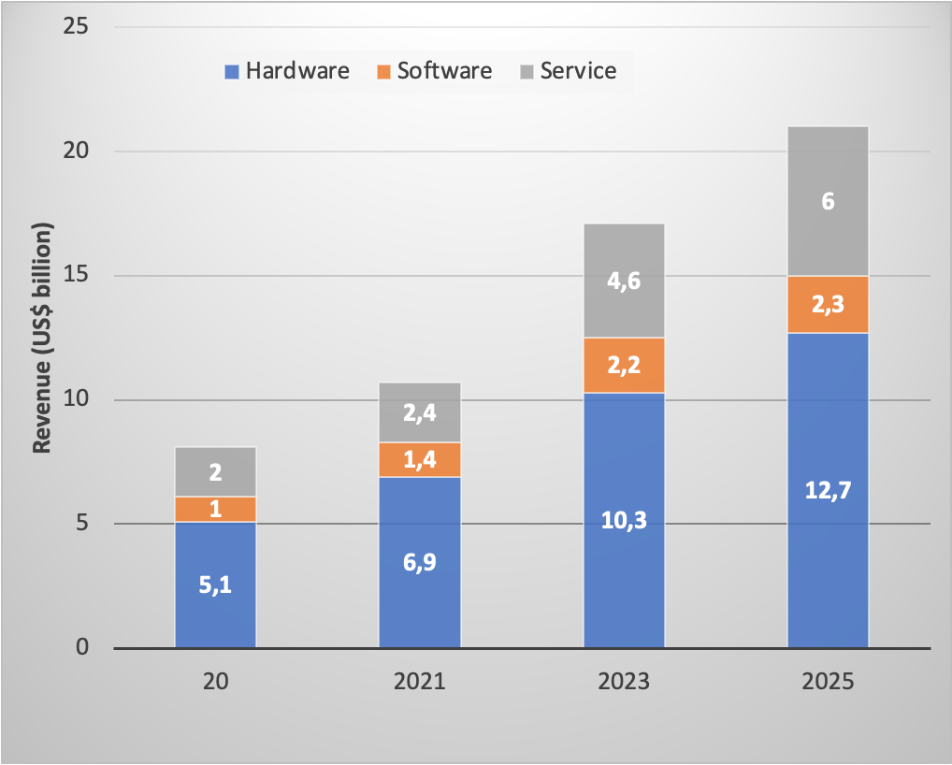
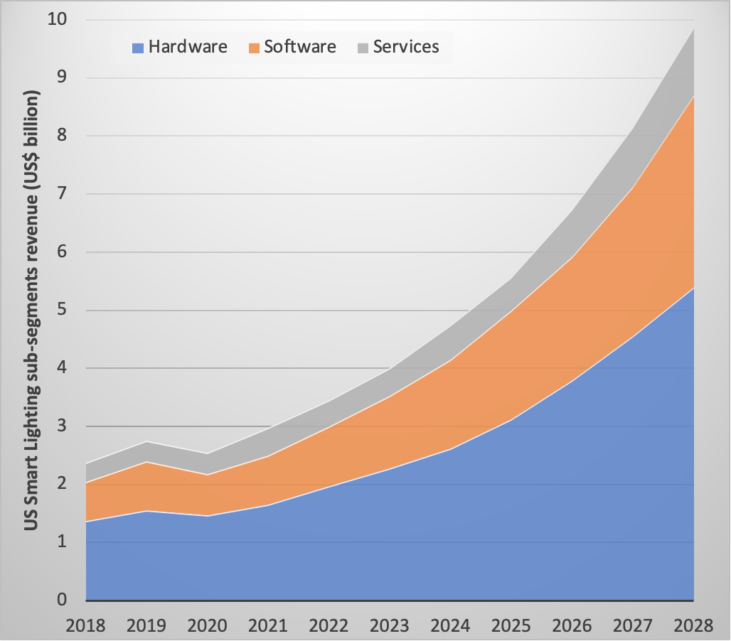
Revenue distribution
Revenue distribution among the 3 marker sub-segments from 2020 to 2025
USA smart lighting revenue by sub-segment.

Slide 8
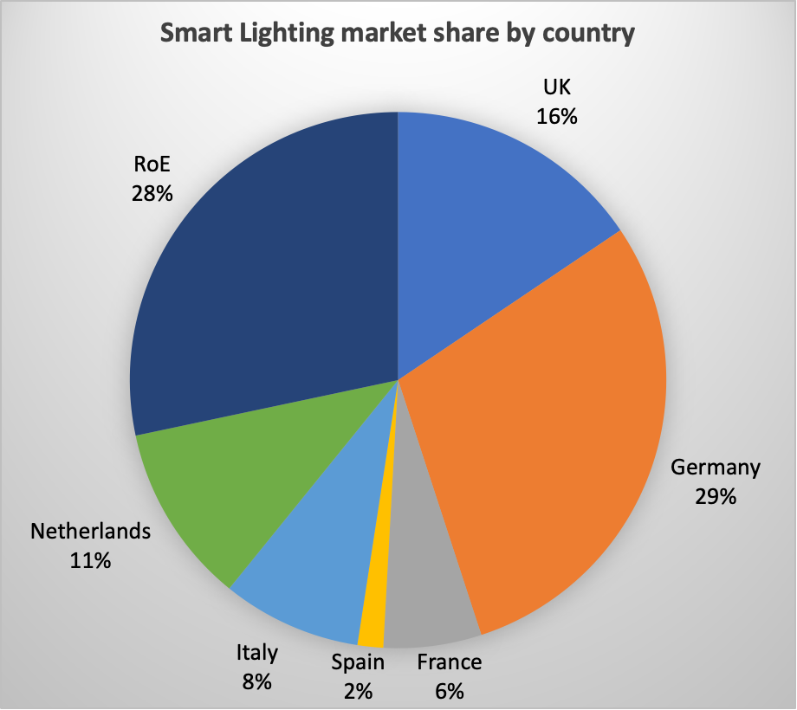
Smart Lighting market share by EU-28 country

Slide 9
Conclusions and Outlook - 1
Today, lighting is responsible for an annual worldwide greenhouse gas emission of 1,38 billion metric tons.
It is foreseen that in 2040 the needs for artificial light shall attain almost 285 Plmh corresponding to an increase of 25% in lighting service demand.
The light source technology evolutions are not sufficient to stem uncontrollable growth. Since 2000’s, the rise of SSL has been considered as the 3rd revolution in the domain of lighting. However, this is not sufficient to inhibit the well-known rebound effect.
Only the transition from the conventional “analogue” lighting technologies to “digital” lighting can do it!
Smart lighting is becoming the 4th revolution and it will be the heart of the “Internet of Things” in smart cities and smart buildings.
.

Slide 10
Conclusions and Outlook - 2
Smart Lighting can achieve more than 40% additional energy savings in the next decade and the market size can exceed EUR 90 billion by 2030.
The residential segment seeks customizable lighting options to create ambiance and cater to individual preferences. A significant trend in the architectural lighting market is the increasing adoption of human-centric lighting solutions. In fact, the global user penetration in the comfort and lighting segment of the smart home market continuously increased between 2023 and 2027 by in total 13,2%.
The dynamics such as rise in demand for intelligent street lighting systems in developing and developed nations, growth in need for energy-efficient lighting systems for sustainable development drive the street-smart lighting market.

Slide 11
Conclusions and Outlook - 2
Smart Lighting can achieve more than 40% additional energy savings in the next decade and the market size can exceed EUR 90 billion by 2030.
The residential segment seeks customizable lighting options to create ambiance and cater to individual preferences. A significant trend in the architectural lighting market is the increasing adoption of human-centric lighting solutions. In fact, the global user penetration in the comfort and lighting segment of the smart home market continuously increased between 2023 and 2027 by in total 13,2%.
The dynamics such as rise in demand for intelligent street lighting systems in developing and developed nations, growth in need for energy-efficient lighting systems for sustainable development drive the street-smart lighting market.

Slide 12
Conclusions and Outlook - 3
The emerging trend of light fidelity (Li-Fi) technology and the increasing adoption of smart lighting in commercial and residential sectors are expected to create promising opportunities for major vendors in the global smart lighting market. Li-Fi is a disruptive technology that will aﬀect numerous industries is Li-Fi.
The technology can unleash the IoT's potential, enabling Industry 4.0 applications and the lighting sector's impending light-as-a-service (LaaS). This VLC protocol can enable big data and other technologies, including IoTs.

Slide 13
Thank you
© European Union 2024
Unless otherwise noted the reuse of this presentation is authorised under the CC BY 4.0 license. For any use or reproduction of elements that are not owned by the EU, permission may need to be sought directly from the respective right holders.
Notes:
Update/add/delete parts of the copy right notice where appropriate.
More information: https://myintracomm.ec.europa.eu/corp/intellectual-property/Documents/2019_Reuse-guidelines%28CC-BY%29.pdf

